Slide 1


All Connection of Hardware with Arduino
Arduino Workshop
IoT Fiesta, 2017
Bangladesh
iotfiesta@bdosn.org

Slide 2


Slide 3
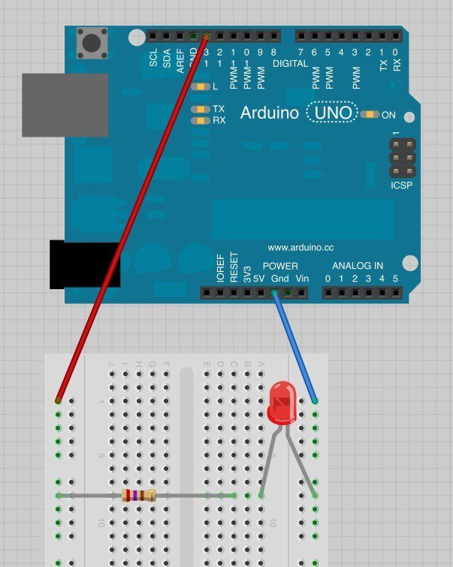
Blinking a LED

Slide 4
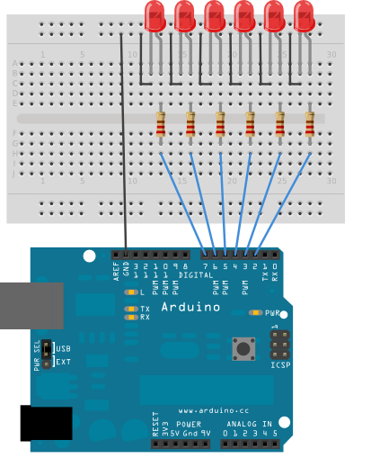
LED looping

Slide 5
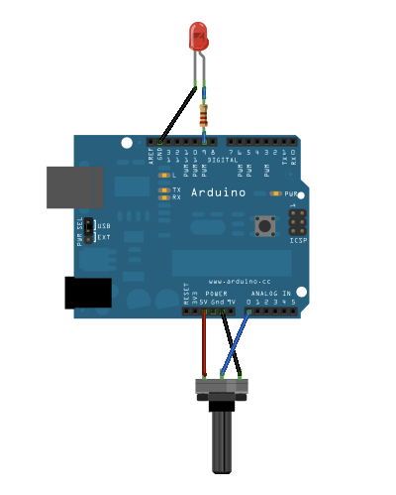
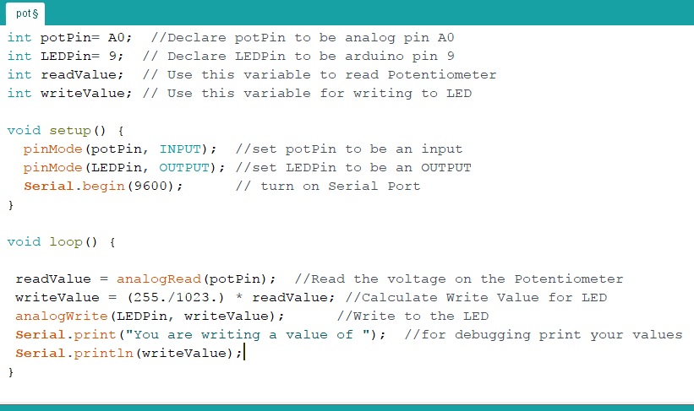

Using Potentiometer

Slide 6
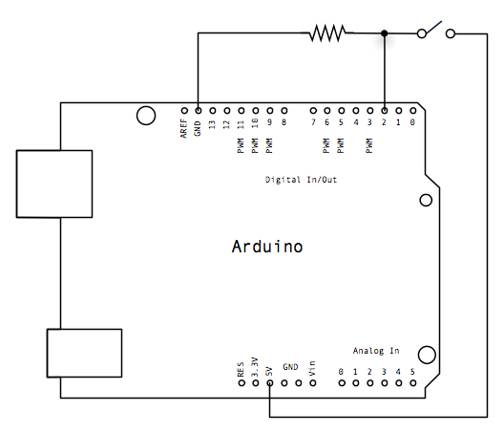
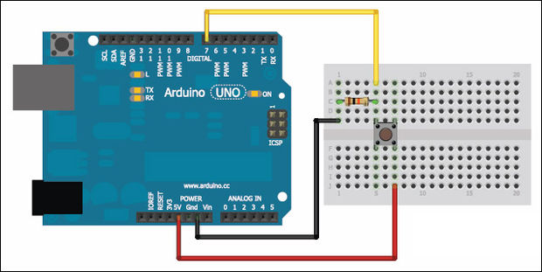

Using Push Button

Slide 7
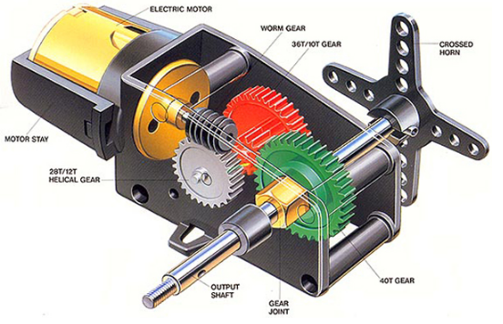
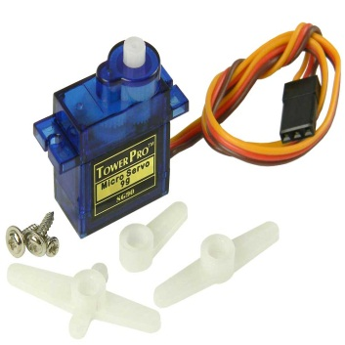
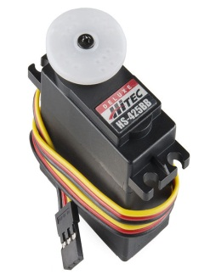
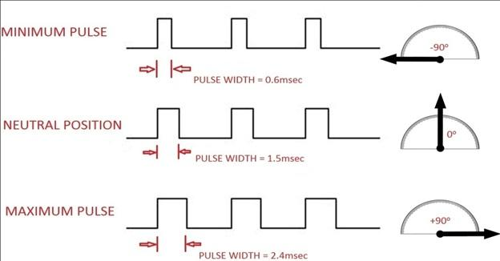
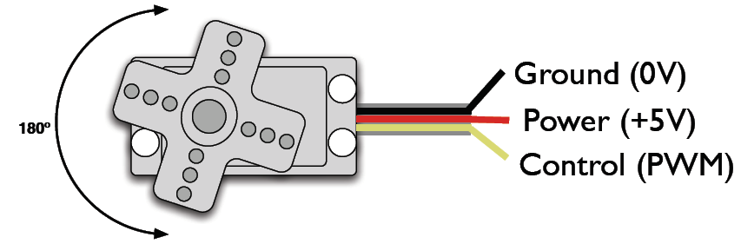
Servo Motor Controlling
What is Servo Motor
Why we need PWM in servo?

Slide 8
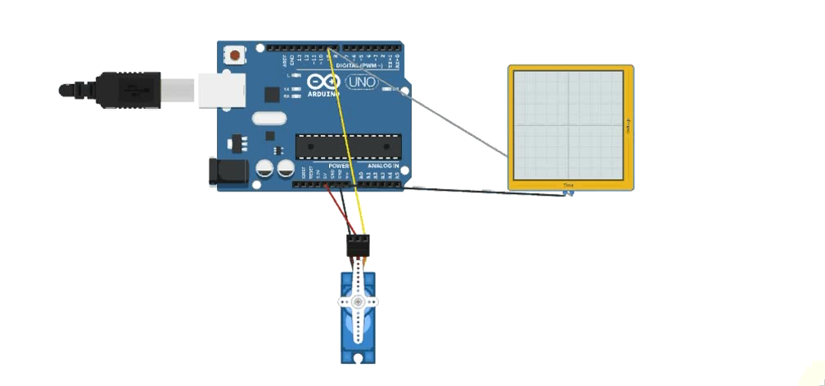
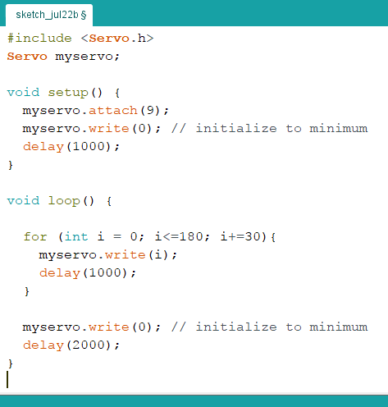
Servo Motor Controlling

Slide 9
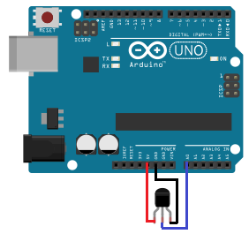
Measuring Temperature using LM35

Slide 10
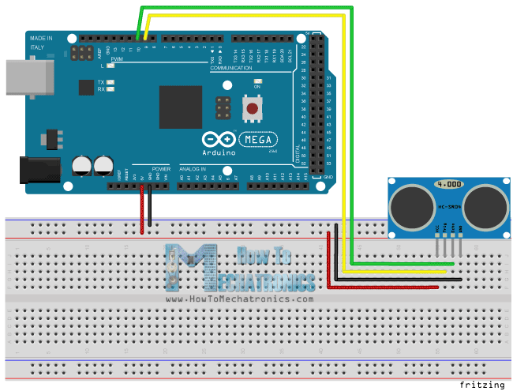


Distance Measuring using Sonar Sensor

Slide 11
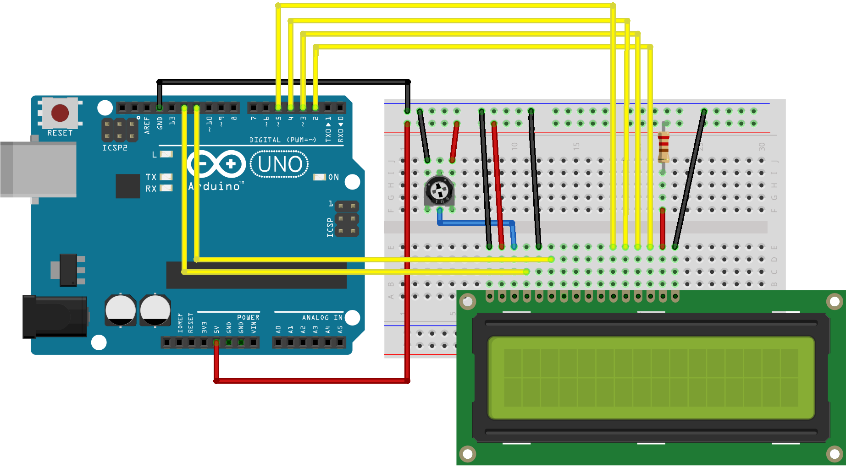
Project: 16x2 Character LCD
Figure: Connection of 16x2 LCD with Arduino
Source: https://www.arduino.cc/en/Tutorial/HelloWorld

Slide 12
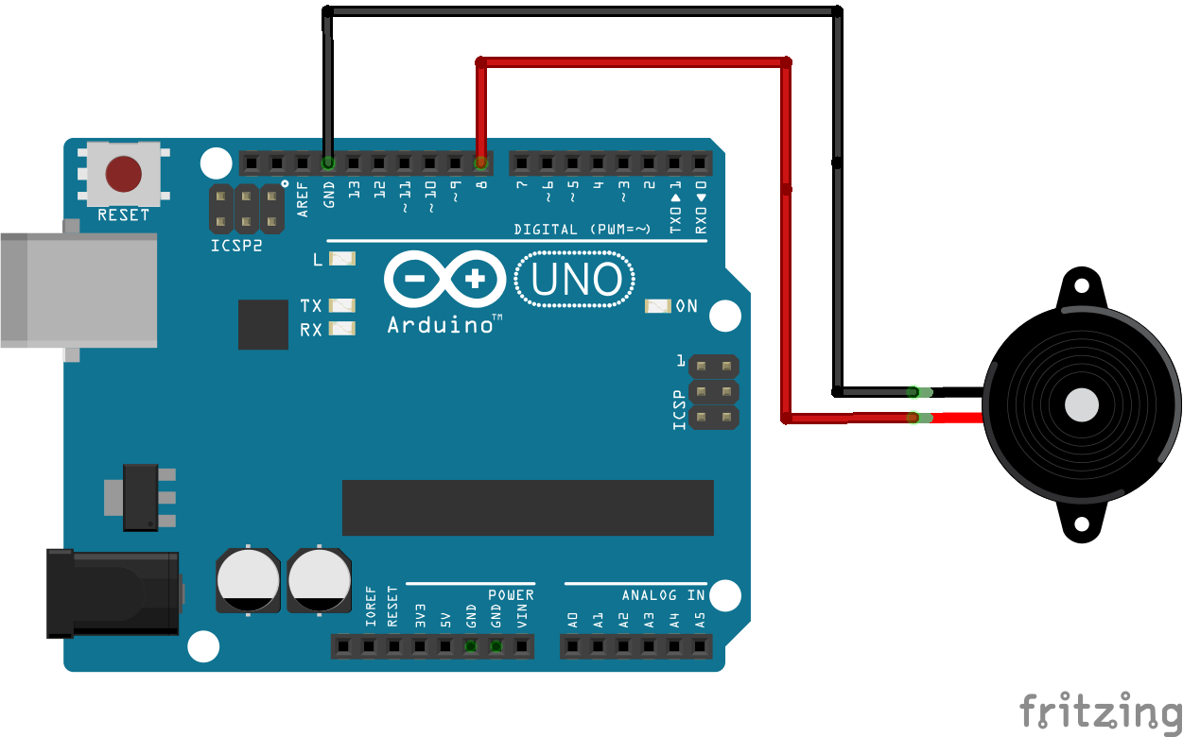
Project : Piezo Buzzer
Figure: Diagram of
Connecting buzzer with Arduino
Source: http://www.instructables.com/id/How-to-use-a-Buzzer-Arduino-Tutorial/

